Slide 1
Level 3
Student’s name:

Slide 2

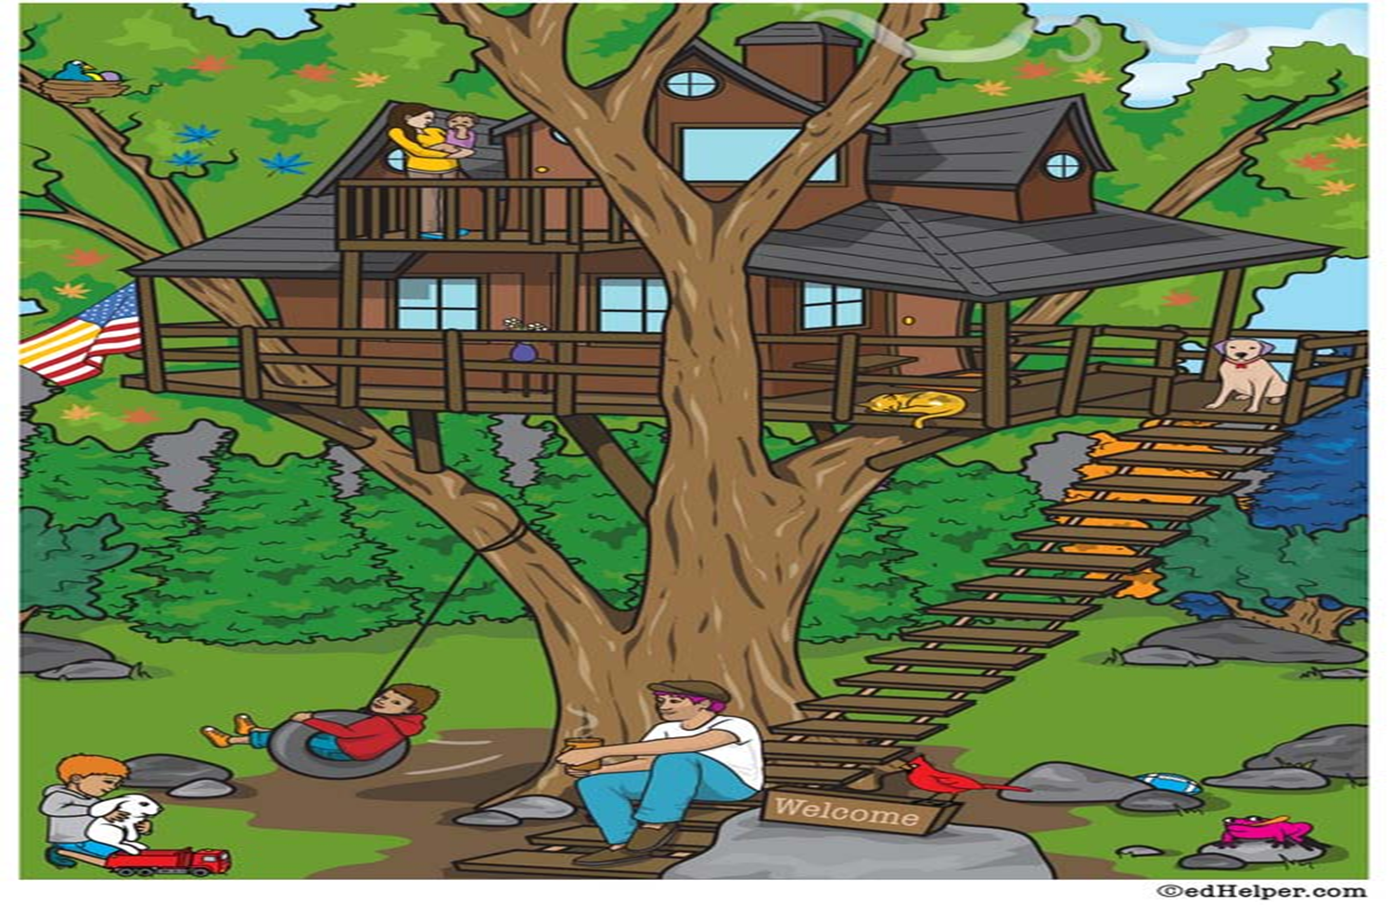
Activity: paste an image and describe what is happening (10 sentences):
The boy is playing with a rabbit
The father is talking to the boys

Slide 3
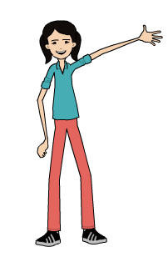
Activity: describe your best friend, using his/her personal information:
Name, last name, age, occupation, telephone number……
My friend
 | She is my friend. Her name is….., she is 15 years old……

Slide 4
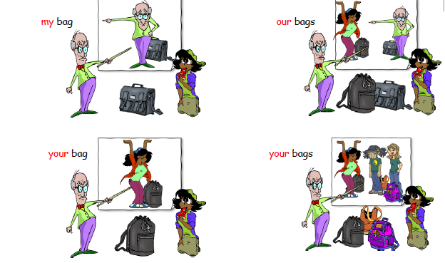
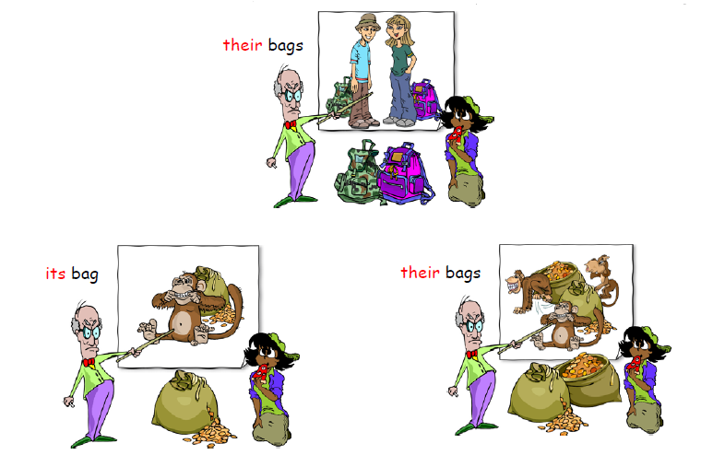
Ressources:
- Verb to be:
http://www.english-4u.de/am_is_are_ex1.htm
Personal information – family members
http://esl.about.com/library/beginner/blfamily.htm
- Possessive adjectives

