Slide 1
The present perfect tense
Reading comprehension
Imperative sentences

Slide 2
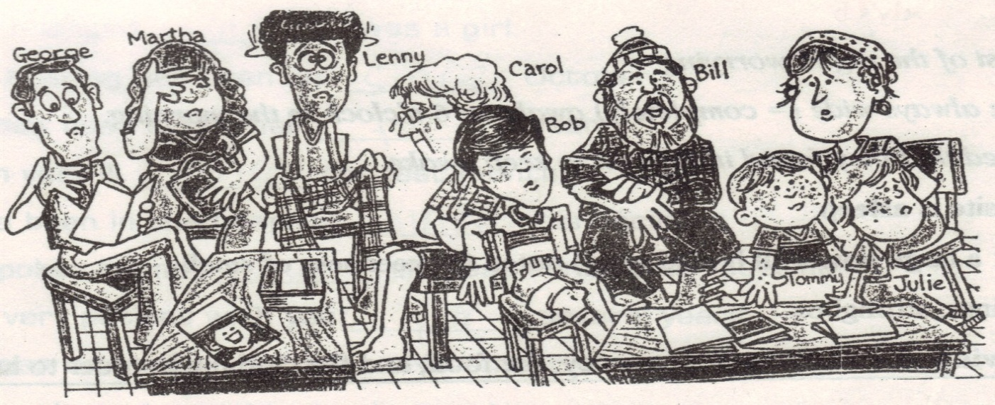
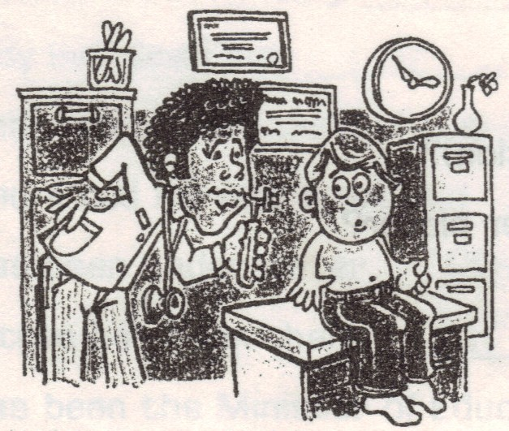
A VERY DEDICATED DOCTOR
1. Dr. Fernando’s waiting room is very full today. A lot of people are waiting to see him, and they’re hoping that the doctor can help them. George’s neck has been stiff for more than a week. Martha has had a headache since yesterday, and Lenny has felt dizzy since early this morning. Carol has had a high fever for two days. Bob’s knee has been swollen for three weeks, Bill’s arm has been black and blue since last week, and Tommy and Julie have had little red spots all over their bodies for the past twenty-four hours.
 | 2. Dr. Fernando has been in the office since early this morning. He has already seen a lot of patients, and he will certainly see many more before the day is over. Dr. Fernando’s patients don’t know it, but he also isn’t feeling very well. He has had a pain in his back since last Thursday, but he hasn’t taken any time to stay at home and rest. He has had a lot of patients this week, and he’s a very dedicated doctor.

Slide 3
According to the last reading answer next questions.
Why isn’t the doctor feeling well?
When are the patients waiting for the doctor?
What has happened with Lenny?
What does the underlined word “him” refer to?
What does the underlined word “them” refer to
Why hasn´t the doctor stayed resting at home?
Why do you think he is a dedicated doctor?
How often does the doctor work?
Where are there many patients?
How is Dr. Fernando feeling?

Slide 4
Use the imperative mode according to the indications below.
IMPERATIVE SENTENCES
Give orders |  | Give directions | Make requests (please) | Give advice | Give warming | Invite someone
Somebody is having a bad behavior in a chat |  | A child needs to cross the street, but he doesn’t know how to do it. | You need to keep in touch with you teacher now to make a socialization process | Your female best friend is in trouble, she is pregnant, and nobody else knows. | You want to leave at the weekend, but your parents will be worried, so they say you: | You are in love, and you are having a date for first time:
Use vocabulary according to this situation |  | See next video and use those verbs | How do you ask your teacher politely to have a communication? | Try to look for a solution, help her with her decisions | Which warnings do they make you? | For inviting you use: “Let’s” “don’t let’s” Let’s go: vámonos
1
2
3
4

